Slide 1
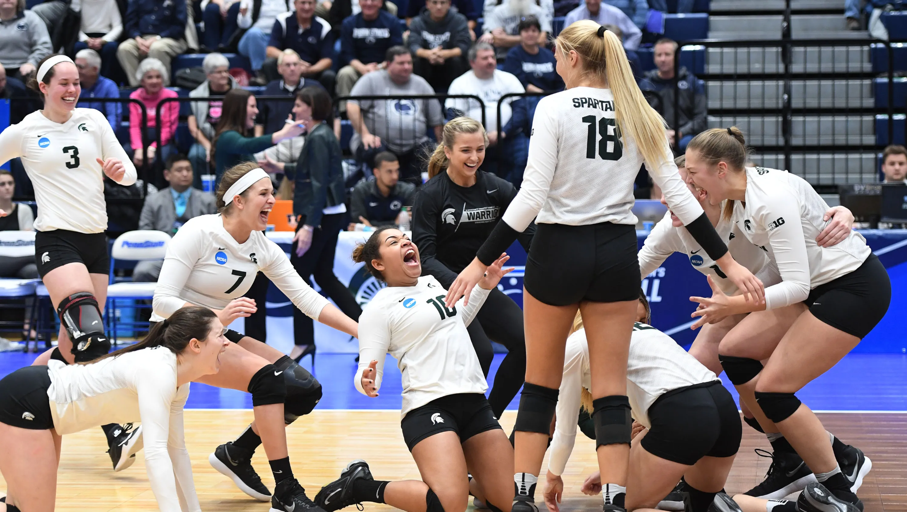
Volleyball Simulation
Burke CMSE 201 005

Slide 2
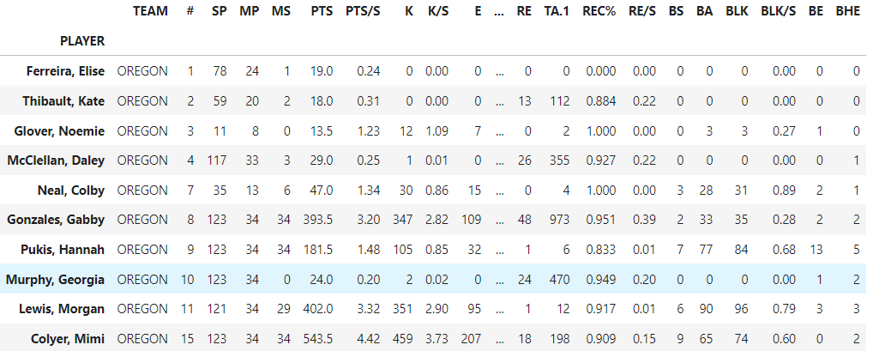
Plan
Can we accurately model a college volleyball game with code to predict its outcome?
So Far: We’ve extracted hundreds of player statistics from dozens of NCAA women’s volleyball teams, have built functions to predict, serving, serve receive, and setting, each specified to react to an athlete’s in game performance to most accurately model their true tendencies in a simulation.
Next: modeling blocking, attacking, and defense
Obstacles: reactive decision making - visual interface - broadcasted point tracking

Slide 3
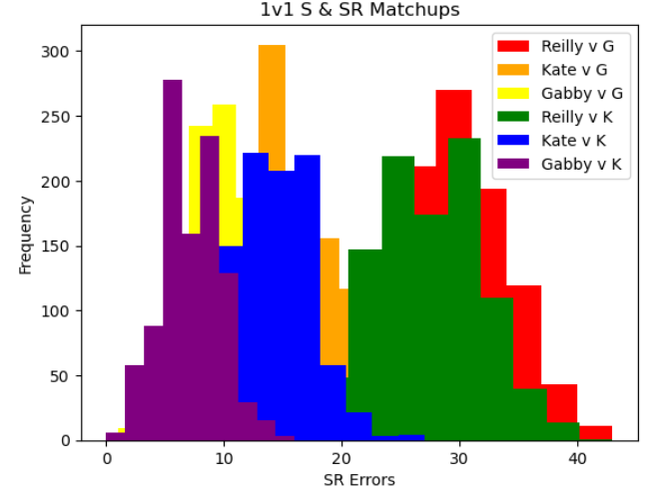
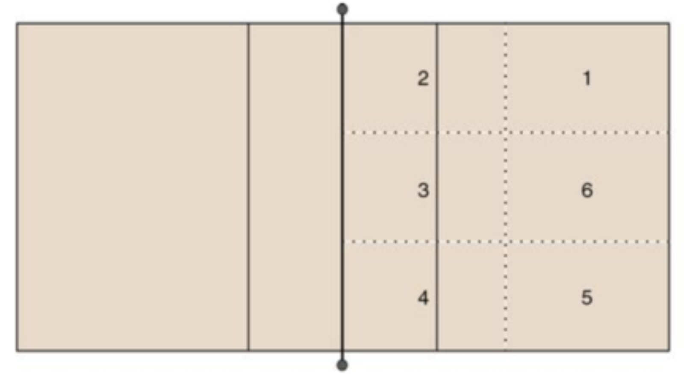
Serve & Receive
Predicting the quality of a serve receive based on player statistics:
Sets Played
Aces
Serve Errors
Receive%
SRError

Slide 4
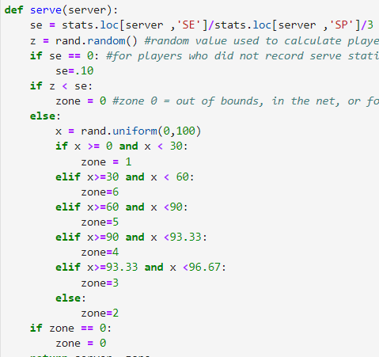
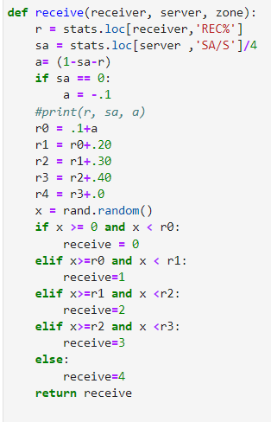

Slide 5
THANK YOU!

